Slide 1

MCA Model Delinquency Prediction
SB
Sivadath Biju

Slide 2

Introduction to the MCA Model
The MCA model is a statistical model that predicts the likelihood of delinquency on motorcycle loans based on a set of variables and credit history.

Slide 3
Factors Considered in MCA Model
Financial Details
Motorcycle details
Analyzed the financial details such as loan amount, term, Amortization etc.
Manufacture, cc, Dealer etc.
Customer Information
personal and demographic data such as Age, Income, Address , civil status etc.
.

Slide 4
Design MCA Model
1
Step 1: Data Pre-processing
Missing values : Mod operation
Categorial feature : On-hot encoding
Scaling : Power transformer
Step 2: Feature Engineering
2
Feature selection: Random forest classifier
New variables: Income to loan ratio, loan to
price ratio, loan tenure years, Monthly debit.
3
Step 3: Model Training
Train set 80 % test 20%
Train/Test samples : Aug 22 to Nov 22
OOT : Dec 22, Jan 23
Step 4: Delinquency Prediction
4
XGboost classifier
Hyper parameters : learning rate(0.1), Lasso(0.1), Ridge(0.1)

Slide 5
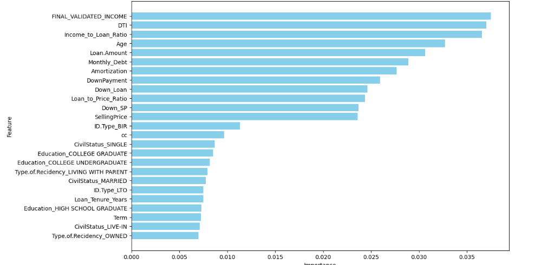
Outcomes
Feature importance score card

Slide 6
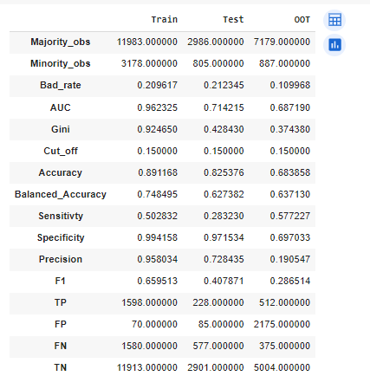
Performance scores

Slide 7
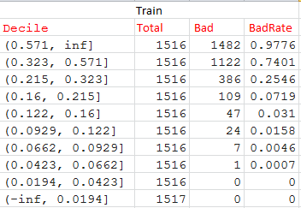
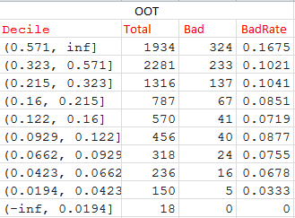
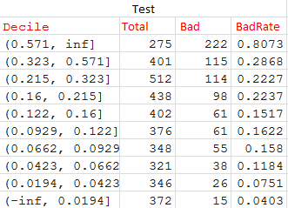
Decile Table

Slide 8


Benefits of Using the MCA Model
Precise Risk Assessment
Data-Driven Insights
The MCA Model provides accurate predictions, enabling proactive risk management and improved decision-making.
Gain valuable insights into the drivers of delinquency and optimize business strategies based on data analysis.

Slide 9

Limitations of the MCA Model
1
Dynamic Market Conditions
2
Data Accuracy
The predictive power depends heavily on the quality and accuracy of input data sources.
The model may be less effective during periods of rapid economic change and market instability.
3
Unforeseen Variables
There may be unforeseen factors or emerging trends that are not captured in the model.

Slide 10

Next steps
Hyper parameter tuning.
Need to tone with time series data.

Slide 11
Thanks.

